Slide 1
AD_excitation
Xingyu Zhang
2022.11.4

Slide 2
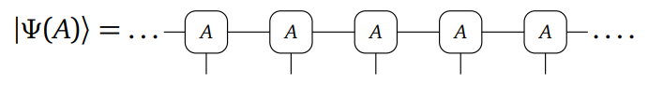
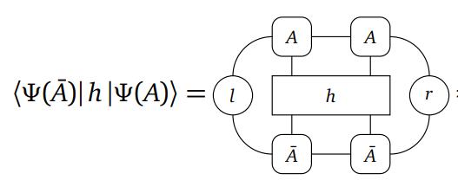
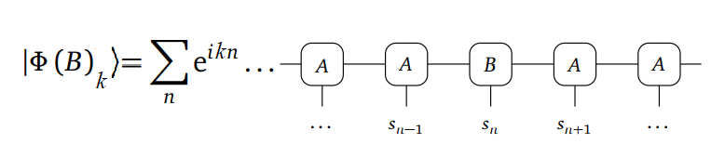
background
Ground state
Quasiparticle ansatz(single-mode approximation)

Slide 3
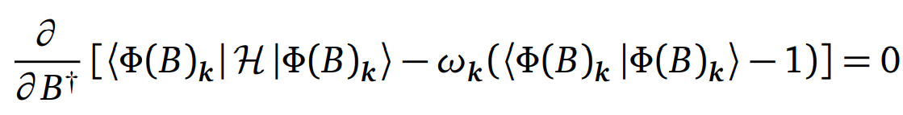
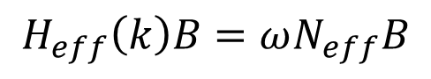
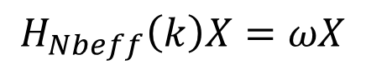
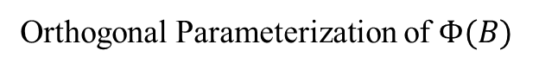
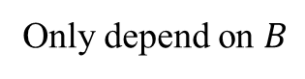
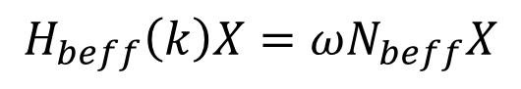
Steps summary and difficulties
graph summation
Only depend on $B$
$$H_{eff}\left(k\right)B=ωN_{eff}B$$
Orthogonal Parameterization of $Φ(B)$
$$H_{beff}\left(k\right)X=ωN_{beff}X$$
ordinary eigenvalue problem
$$H_{Nbeff}\left(k\right)X=ωX$$

Slide 4
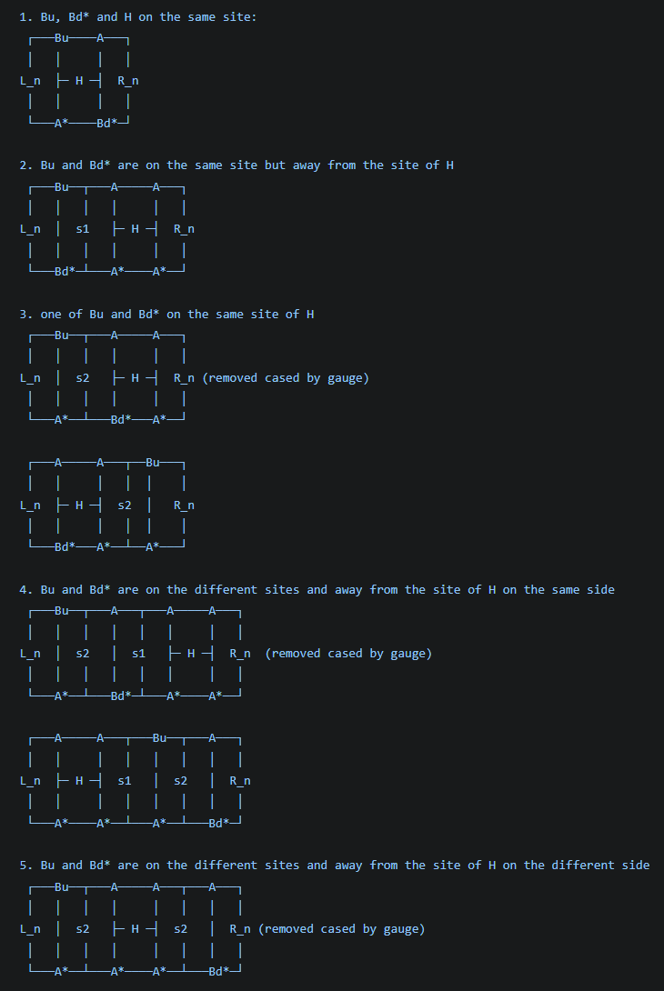
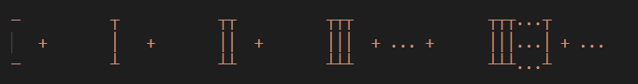
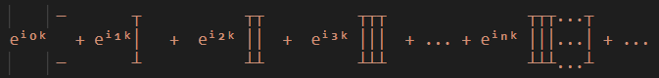
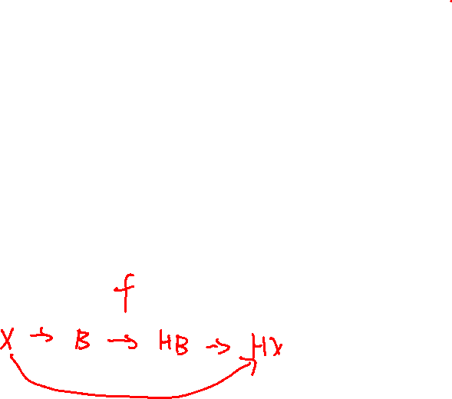
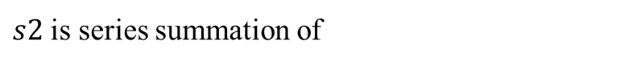
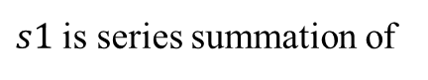
Correct graph summation
Correct series summation
$s1$ is series summation of
$s2$ is series summation of
They are divergent

Slide 5
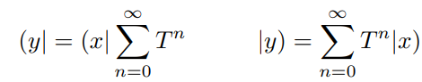
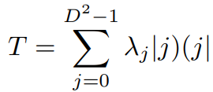
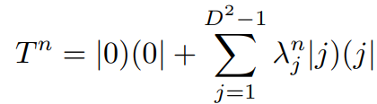
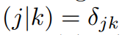
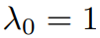
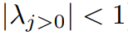
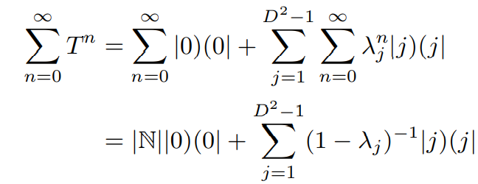
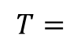
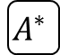

Geometric Sums of Transfer Matrices(1/3)
Geometric Sums
decomposition
$$A$$
$$T=$$
$$A^{∗}$$
divergent

Slide 6
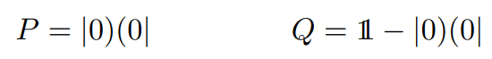
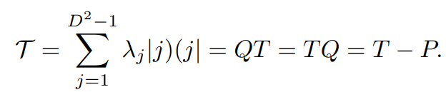
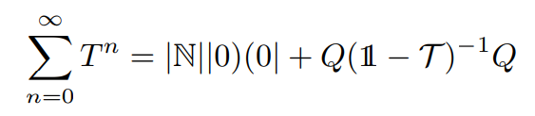
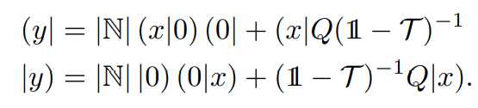
Geometric Sums of Transfer Matrices(2/3)
projectors
The diverging contributions can typically be safely discarded, as they correspond to a constant (albeit infinite) offset of some extensive observable (e.g. the Hamiltonian).

Slide 7
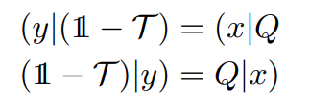
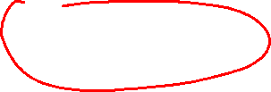
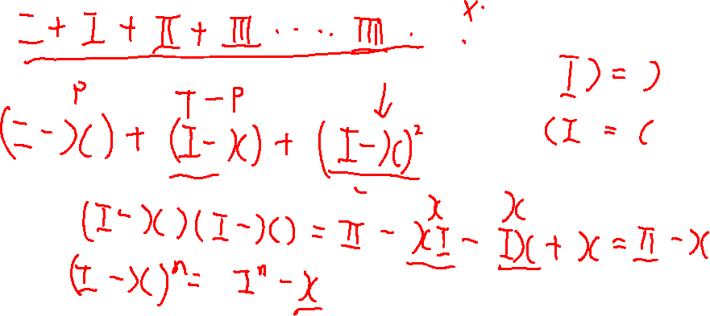
Geometric Sums of Transfer Matrices(3/3)
Linear solve

Slide 8
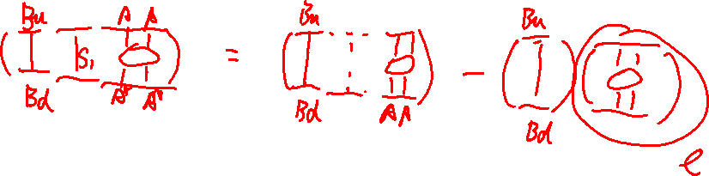

Slide 9
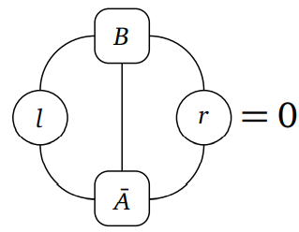
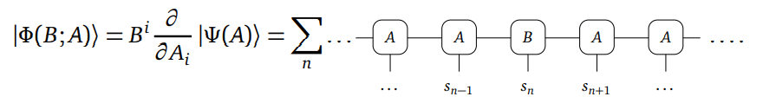
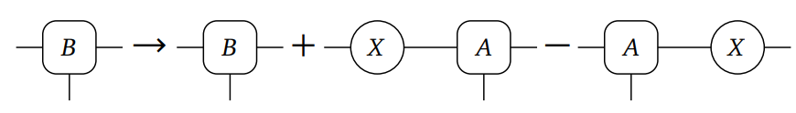
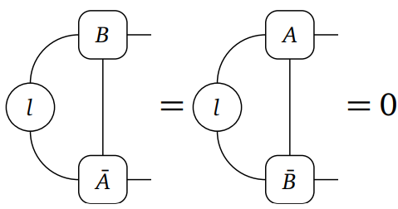
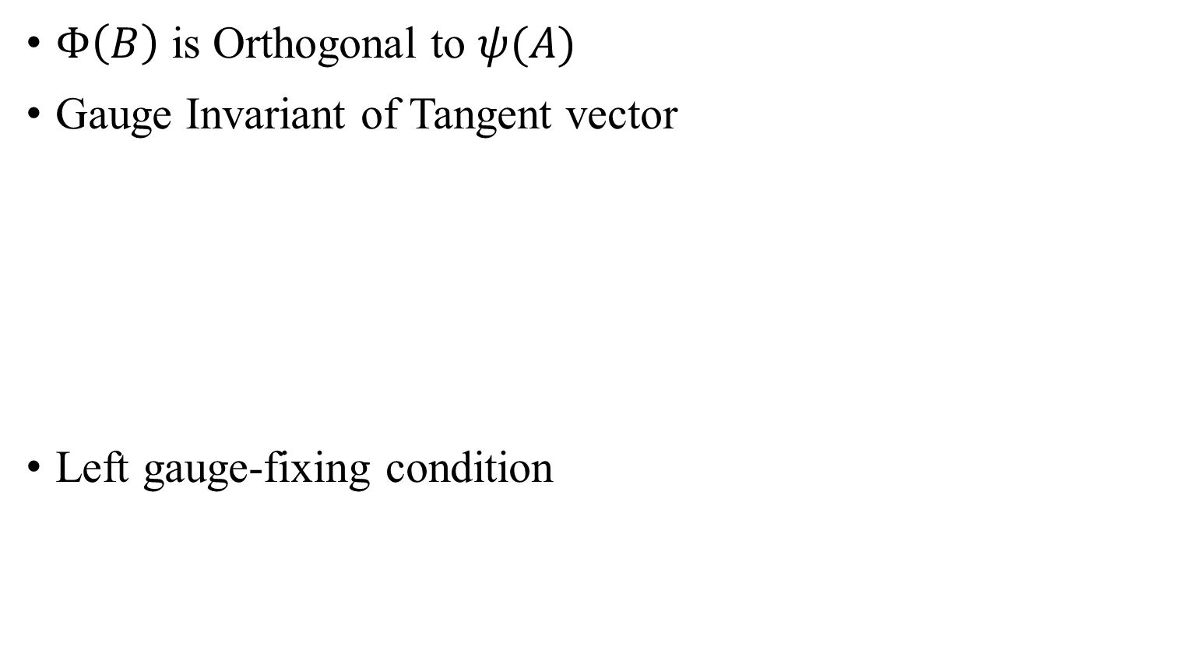
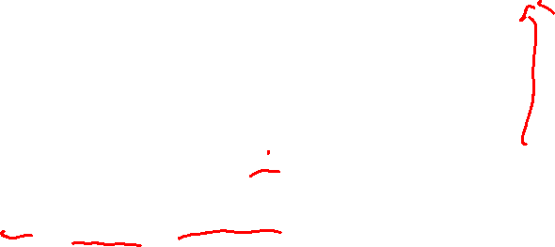
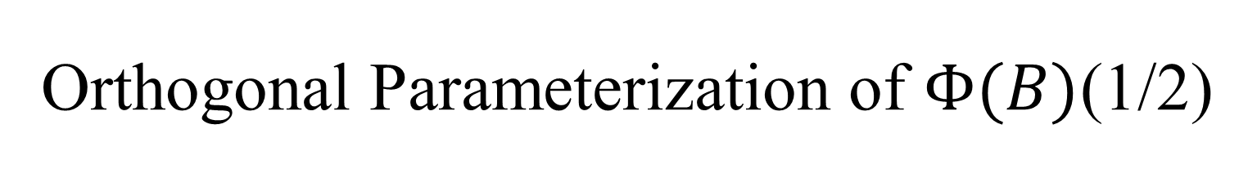
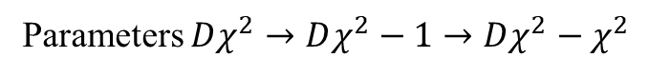
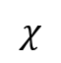
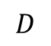
Orthogonal Parameterization of $Φ(B)$(1/2)
$$χ$$
$Φ\left(B\right)$ is Orthogonal to $ψ(A)$
Gauge Invariant of Tangent vector
Left gauge-fixing condition
$$D$$
Parameters $Dχ^{2}→Dχ^{2}−1→Dχ^{2}−χ^{2}$

Slide 10
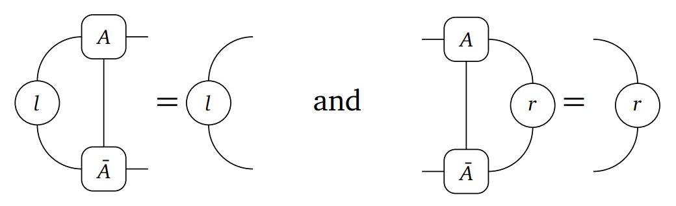
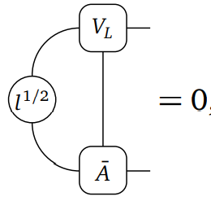
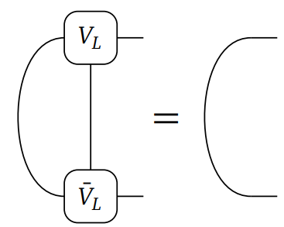
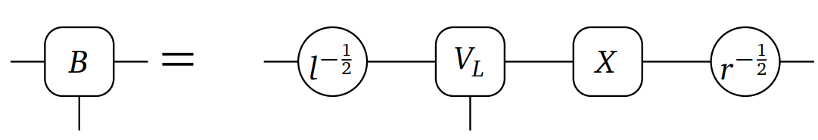
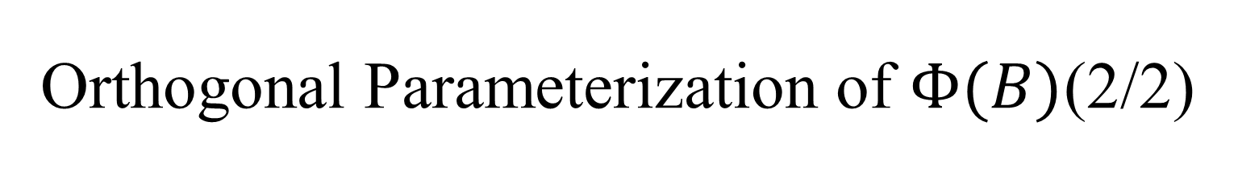
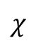
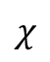
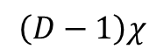

Orthogonal Parameterization of $Φ(B)$(2/2)
parameterization
$$\left(D−1\right)χ$$
$$χ$$
$$\left(D−1\right)χ$$
$$χ$$

Slide 11
test

Slide 12








ordinary eigenvalue problem
$N_{eff}→N_{beff}$
$$HX$$
=
$$l^{\frac{1}{2}}$$
$$HB$$
$$r^{\frac{1}{2}}$$
$${\overline{V}}_{L}$$

Slide 13




Ground state by AD
Heisenberg $S=1/2$

Slide 14



gap
Heisenberg $S=1/2$
Heisenberg $S=1$

Slide 15




$k = π$Haldane gap error
For $χ=256$
AD for ground state ~ 8h 10000 steps
Eigsolve for excitation state ~ 500s

Slide 16




Heisenberg $S=1$excitation spectrum

Slide 17


MPO graph summation
s2

Slide 18













MPO
TFIsing
$$2$$
$$3$$
$$\hat{W}$$
$$3$$
$$2$$
$$A$$
The 王 MPO transfer matrix contains Jordan blocks and that the dominant eigenvalue is one and of twofold algebraic degeneracy.
Overlap(E, Ǝ) = 0 E王Ǝ = 0
MPO transfer matrices technically do not have well defined fixed points. $→$ quasi fixed points
$$\hat{W}$$
$$A^{∗}$$

Slide 19








Fixed point equations
Left and right environment EƎ
$$A$$
$C_{a}=C_{a}工^{aa}+C_{a}$ $C_{a}=\sum_{b>a}{C_{b}}工^{ba}$
$Ɔ_{a}=工^{aa}Ɔ_{a}+Ɔ_{a}$ $Ɔ_{a}=\sum_{b<a}{ }工^{ab}$ $Ɔ_{b}$
$${ \hat{W}}^{ab}$$
$工^{ab}$=
$工^{aa}=0$
$$C_{a}=C_{a}$$
$$Ɔ_{a}=Ɔ_{a}$$
$工^{aa}=λ_{a}工$
$C_{a}={λ_{a}C}_{a}工+C_{a}$ $C_{a}(1−λ_{a}工)=C_{a}$
$Ɔ_{a}=λ_{a}工Ɔ_{a}+Ɔ_{a}$ ${(1−λ_{a}工)Ɔ}_{a}=Ɔ_{a}$
$工^{aa}=工$
$C_{a}(1−工)=C_{a}$
$$(1−工)Ɔ_{a}=Ɔ_{a}$$
$$C_{a}\left(1−工−\text{ɔ}c\right)=C_{a}−C_{a}\text{ɔ}\text{c}$$
$$\left(1−工−\text{ɔ}c\right)Ɔ_{a}=Ɔ_{a}−\text{ɔ}cƆ_{a}$$
energy= $cƆ_{w}$= $C_{1}\text{ɔ}$
$$A^{∗}$$
$$A$$
工=
$$A^{∗}$$

Slide 20


Slide 21
2D excitation spectrum on Helix
Xingyu Zhang
2023.1.5

Slide 22


Review and contents
single-mode approximation
1D excitation spectrum
Orthogonal Parameterization
Graph summation
Eigen equation
Two site Hamiltonian
MPO (much simpler! quasi fixed points)
2D excitation spectrum
1D to 2D
cylinders
Large unit cell; $k_{y}$ is not a good quantum number
helix
Single unit cell; $k_{y}$ is a good quantum number

Slide 23



Direct 2D single-mode approximation
High computational cost
No innovation point

Slide 24



1D$→$2D map
Cylinder
Helix
$$W$$

Slide 25









1D$→$2D map
Cylinders
Helix
$W=4$ for example
NN
NN
1,3,4
$$A_{1}$$
1, 4
$$A$$
1, 4
$$A_{2}$$
1, 4
$$A$$
1, 4
$$A_{2}$$
1, 4
$$A$$
1,3,4
$$A_{1}$$
1, 4
$$A$$
Unit cell length=4
Single unit!

Slide 26













MPO from matrix product (MP) diagram
1D TFIsing
1D Heisenberg
$$H=\sum_{i}{−σ_{i}^{z}σ_{i+1}^{z}−λσ_{i}^{x}}$$
$$=−σ_{1}^{z}σ_{2}^{z}I_{3}I_{4}…−σ_{1}^{x}I_{2}I_{3}I_{4}$$
$−{I_{1}σ}_{2}^{z}σ_{3}^{z}I_{4}…−I_{1}σ_{2}^{x}I_{3}I_{4}$
$−{I_{1}I_{2}σ}_{3}^{z}σ_{4}^{z}…−I_{1}I_{2}σ_{3}^{x}I_{4}$
$$H=\sum_{i}{{S_{i}^{x}S_{i+1}^{x}+S_{i}^{y}S_{i+1}^{y}+S}_{i}^{z}S_{i+1}^{z}}$$
1
$$I$$
2
$$S^{x}$$
1
$$I$$
3
$$S^{y}$$
2
$$σ^{x}$$
$$S^{z}$$
3
$$σ^{z}$$
4
2
5
N
N
$$M=\left[\begin{matrix}I & S^{x} & S^{y} & S^{z} & 0 \\ 0 & 0 & 0 & 0 & S^{x} \\ 0 & 0 & 0 & 0 & S^{y} \\ 0 & 0 & 0 & 0 & S^{z} \\ 0 & 0 & 0 & 0 & I\end{matrix}\right]$$
2
$$M=\left[\begin{matrix}I & −σ^{z} & {−σ}^{x} \\ 0 & 0 & σ^{z} \\ 0 & 0 & I\end{matrix}\right]$$
$$N=3$$
$$N=5$$

Slide 27







MPO from matrix product (MP) diagram
TFIsing
Heisenberg
NN NN-2
NN NN-2
1
$$I$$
2
$$σ^{x}$$
1
$$I$$
$$σ^{z}$$
2
$$S^{x}$$
3
$$S^{y}$$
4
3
$$S^{z}$$
4
NN NN-3
5
1
6
2
7
3
N=2+W
N= 2+3W
8
4
2
5
N
N
2

Slide 28





Ground state vumps
1D TFIsing NN
1D Heisenberg NN
$$λ_{c}=\text{1}$$
$S=1$ Haldane gap

Slide 29






Ground state vumps
2D TFIsing
2D Heisenberg NN
$$λ_{c}=\text{3.04438}$$
Different approach with $D$ v.s. $W$
Nonmonotonicity with $W$ and $χ$

Slide 30





excitation spectrum
Cylinder
Helix
$$\left.\left|Φ_{k_{x},k_{y}}(B)\right.\right\rangle =\sum_{n}{e^{ik_{x}\text{⌊}\text{n}\text{/}\text{W}\text{⌋}+ik_{y}(n mod W)}T_{x}T_{y}}$$
No $k_{y}$ because $k_{y}$ is not a good quantum number
$k_{y}$ is a good quantum number
Recover by directly calculating

Slide 31





translation operator
$$\left.\left|Φ{\left(B\right)}_{k}\right.\right\rangle =e^{ik ⋅0}$$
$+$ $e^{ik ⋅1}$
$+$ $e^{ik ⋅2}$
$+$ $e^{ik ⋅3}$
$$B$$
$$\left.T\left|Φ{\left(B\right)}_{k}\right.\right\rangle =e^{ik ⋅0}$$
$+$ $e^{ik ⋅1}$
$+$ $e^{ik ⋅2}$
$+$ $e^{ik ⋅3}$
$$B$$
$$\left.e^{−ik}\left|Φ{\left(B\right)}_{k}\right.\right\rangle =\left.T\left|Φ{\left(B\right)}_{k}\right.\right\rangle$$

Slide 32





translation operator $T_{y}$
$$T_{y}$$
Cylinder
$W=4$ for example
$$T_{x}$$
$$\left.\left|Φ{\left(B\right)}_{k_{x},k_{y}}\right.\right\rangle =e^{ik_{x} ⋅0+ik_{y}⋅0} +e^{ik_{x} ⋅0+ik_{y}⋅1}$$
$+e^{ik_{x} ⋅0+ik_{y}⋅2} +e^{ik_{x} ⋅0+ik_{y}⋅3}$
$$T_{y}$$

Slide 33


translation operator $T_{y}$
$$T_{y}$$
Cylinder
$W=4$ for example
$$T_{x}$$
$$\left.\left|Φ{\left(B\right)}_{k_{x},k_{y}}\right.\right\rangle =e^{ik_{x} ⋅0+ik_{y}⋅0} +e^{ik_{x} ⋅0+ik_{y}⋅1}$$
$+e^{ik_{x} ⋅0+ik_{y}⋅2} +e^{ik_{x} ⋅0+ik_{y}⋅3}$
$$T_{y}$$
$k_{y}$is not a good quantum number!

Slide 34



translation operator $T_{y}$
$$T_{y}$$
Helix
$W=4$ for example
$$T_{x}$$
$$\left.\left|Φ{\left(B\right)}_{k_{x},k_{y}}\right.\right\rangle =e^{ik ⋅0+ik_{y}⋅0} +e^{ik ⋅0+ik_{y}⋅1}$$
$+e^{ik ⋅0+ik_{y}⋅2} +e^{ik ⋅0+ik_{y}⋅3}$
$$T_{y}$$
$k_{y}$is a good quantum number!

Slide 35

Graph summation

Slide 36


Graph summation
$$\left|\left.\right\rangle \right.=e^{ik ⋅0+ik_{y}⋅0}$$
$W=4$ for example
$$S^{+_{1}}=e^{ik_{x}⋅0+ik_{y}⋅1}三+e^{ik_{x}⋅0+ik_{y}⋅2}王+e^{ik_{x}⋅0+ik_{y}⋅3}王^{2}$$
$$\left\langle \left.\right|\right.=$$
$${+e}^{ik_{x}⋅1+ik_{y}⋅0}王^{3}+e^{ik_{x}⋅1+ik_{y}⋅1}王^{4}+e^{ik_{x}⋅1+ik_{y}⋅2}王^{5}+e^{ik_{x}⋅1+ik_{y}⋅3}王^{6}$$

Slide 37



Graph summation
$$S^{+_{1}}=\left(e^{ik_{x}⋅0+ik_{y}⋅1}三+e^{ik_{x}⋅0+ik_{y}⋅2}王+e^{ik_{x}⋅0+ik_{y}⋅3}王^{2}{+e}^{ik_{x}⋅1+ik_{y}⋅0}王^{3}\right)⋅$$
$$\left(三+e^{ik_{x}⋅1}王^{4}+e^{ik_{x}⋅2}王^{8}+…\right)$$
$$≡\left(e^{ik_{x}⋅0+ik_{y}⋅1}三+e^{ik_{x}⋅0+ik_{y}⋅2}王+e^{ik_{x}⋅0+ik_{y}⋅3}王^{2}{+e}^{ik_{x}⋅1+ik_{y}⋅0}王^{3}\right)S_{4}^{+}$$
$$S^{+}=S^{+_{1}}+S^{+_{2}}+S^{+_{3}}+S^{+_{4}}=\left(\left({3e}^{ik_{x}⋅0+ik_{y}⋅1}+e^{ik_{x}⋅1−ik_{y}⋅3}\right)三+\left(2e^{ik_{x}⋅0+ik_{y}⋅2}+2e^{ik_{x}⋅1−ik_{y}⋅2}\right)王+{(e}^{ik_{x}⋅0+ik_{y}⋅3}+3e^{ik_{x}⋅1−ik_{y}⋅1})王^{2}{+4e}^{ik_{x}⋅1+ik_{y}⋅0}王^{3}\right)S_{4}^{+}$$
Same way:
$$S^{−}=S^{−_{1}}+S^{−_{2}}+S^{−_{3}}+S^{−_{4}}=\left(\left({3e}^{ik_{x}⋅0−ik_{y}⋅1}+e^{−ik_{x}⋅1+ik_{y}⋅3}\right)三+\left(2e^{ik_{x}⋅0−ik_{y}⋅2}+2e^{−ik_{x}⋅1+ik_{y}⋅2}\right)王+{(e}^{ik_{x}⋅0−ik_{y}⋅3}+3e^{−ik_{x}⋅1+ik_{y}⋅1})王^{2}{+4e}^{−ik_{x}⋅1+ik_{y}⋅0}王^{3}\right)S_{4}^{−}$$
$$S_{4}^{−}=\left(三+e^{−ik_{x}⋅1}王^{4}+e^{−ik_{x}⋅2}王^{8}+…\right)$$

Slide 38




result
2D TFIsing $k_{y}=0$

Slide 39




result
2D TFIsing $k_{y}=π$

Slide 40



result

Slide 41
outlook
1D anti-Heisenberg, Large unit cell
2D anti-Heisenberg
Kitaev

Slide 42
Thank you for listening!
Q&A?

